Slide 1

CUSTOMER BOOKING DATA ANALYSIS & PREDICTIVE MODELLING
SHANMUGAPRIYA KUMAR/ 16-12-24

Slide 2
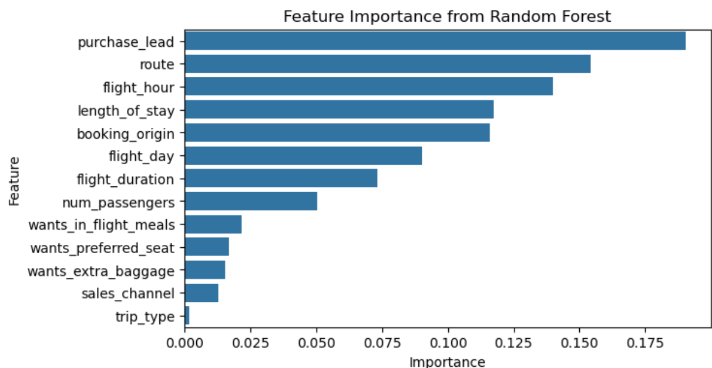
PREDICTIVE MODEL – RANDOM FOREST - To identify the top 5 factors influencing customer booking
Feature Importance :
1.Purchase_lead =0.1903
2.Route =0.1541
3.Flight_hour =0.1398
4.Length_of_stay = 0.1175
5.Booking_origin = 0.1160
Accuracy score:
-Model predicted with accuracy of 86 %

